Slide 1

Next Gen Shopping Augmented Reality Meets Retail
20XX
20XX
CREATIVE STARTUP

Slide 2

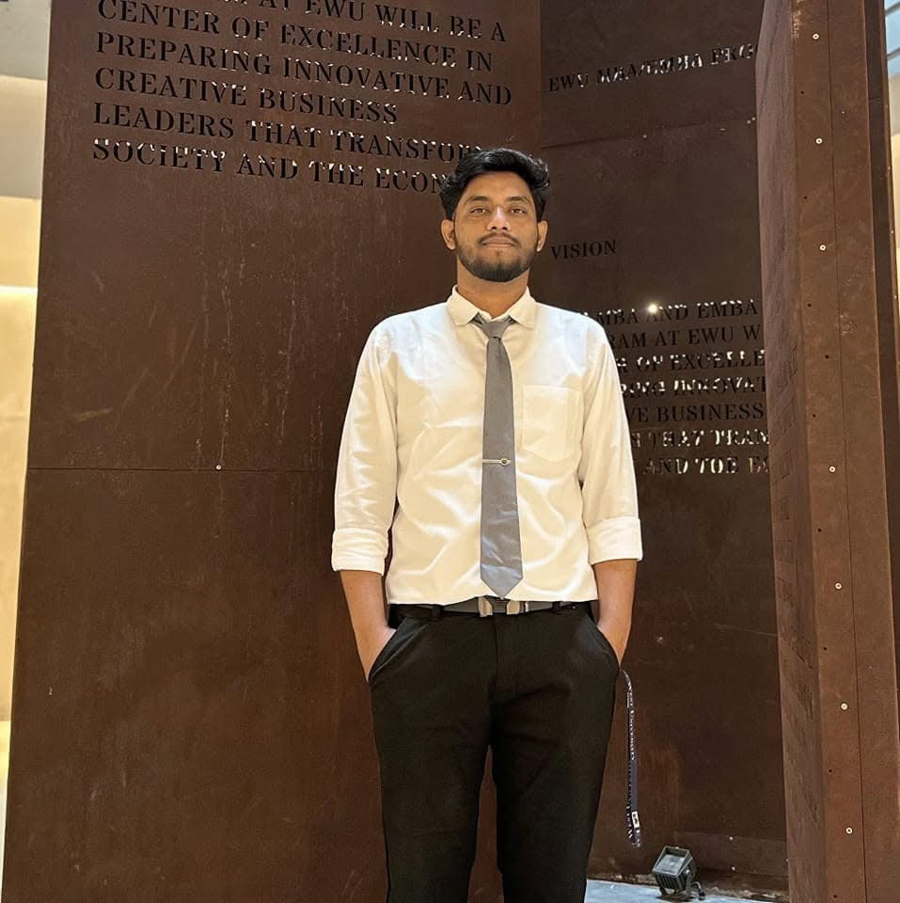
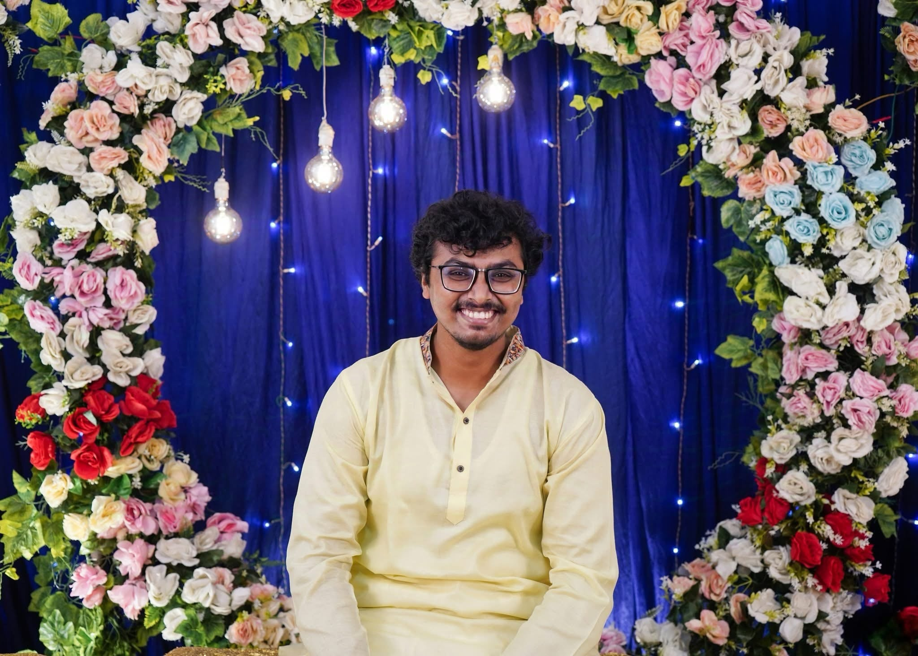


OUR TEAM
20XX
Deepak Chandra Roy
Adjunct Faculty
East West University
Deputy Manager (ICT Development)
Dhaka Power Distribution Company Ltd. (DPDC)
Rafsun Islam Taskin
2021-3-60-024
Tasfia Tahsin Annita
2021-3-60-031
B. M. Shahria Alam
2021-3-60-016
A.B.M Ilman Farabi
2021-3-60-111

Slide 3

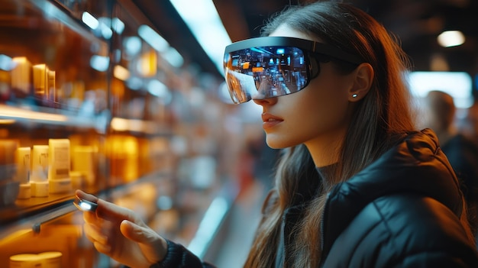

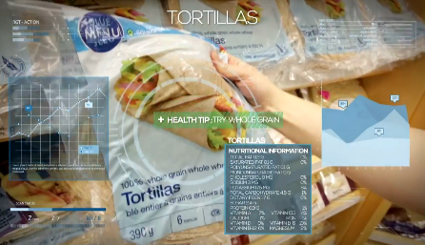
01
Introduction
2022
Content
02
Key Features & Benefits
03
SWOT Analysis & Target Market
04
Project Charter
05
Work Break Down Structure
06
Gantt Chart
07
Network Diagram
08
Software Costing
09
Conclusion

Slide 4
INTRODUCTION
20XX
A revolutionary platform combining Augmented Reality (AR) and Artificial Intelligence (AI) to enhance the shopping experience.
Traditional retail lacks engagement and personalization. AR brings interactivity, fun, and tailored shopping experiences.
To create a scalable and engaging AR shopping solution that enhances user satisfaction and boosts retail performance.

Slide 5


Key Features
20XX
Interactive shopping with real-time product information and virtual try-ons.
Seamless experience across physical and digital shopping platforms.
Engagement through AR-enabled rewards, quests, and challenges.
Behavior-based recommendations and custom shopping paths.

Slide 6

Benefits
20XX
Customer-Centric: Enhanced experience with interactive and engaging shopping.
Increased Retention: Personalization boosts customer loyalty and satisfaction.
Competitive Edge: Retail stores leverage AR to stand out in a competitive market.

Slide 7
TARGET Market
20XX
AGE
SPEND PER CUSTOMER (avg)
1500 BDT
50%
35%
15%
21 - 30
31 - 40
41 - 50
Engagement
INTERESTS
GENDER
Man
55%
Engagement
Personalization
Woman
45%
Convenience
Innovation

Slide 8
SWOT ANALYSIS
STRENGTHS
WEAKNESSES
OPPORTUNITIES
THREATS
20XX
S
W
Innovative use of AR and AI for an engaging and personalized shopping experience.
High initial development and implementation costs; reliance on user adoption of AR tools.
O
T
Growing market for immersive technologies and customer demand for smarter shopping solutions.
Competition from similar technologies and resistance from non-tech-savvy consumers.

Slide 9



Marketing Strategy
Social Media Ad Showcasing AR Feature
Collaborations with influencers for Demo
In-Store and Online Promotions featuring Gamification
20XX

Slide 10
Project Charter
20XX
Project Title | Next-Gen Shopping: Augmented Reality meets Retail
Project Manager | Tasfia Tahsin Annita | Project Sponsor | Deepak Chandra Roy
Project Start Date | 01/11/2024 | Project End Date | 21/09/2025
Name | Department | Internal/External
Retail Shop Owners | Retail | External
Customers Utilizing Smart Glasses | Retail | External
AR Software Developers | CSE | Internal
Marketing and Analytics Teams | Marketting | Internal
Name | Department | ID | Role
Tasfia Tahsin Annita | CSE | 2021-3-60-031 | Project Manager
B. M. Shahria Alam | CSE | 2021-3-60-016 | Developer
Rafsun Islam Taskin | CSE | 2021-3-60-024 | Designer
A.B.M. Ilman Farabi | CSE | 2021-3-60-111 | QA Tester
Business need The project aims to achieve a revolutionized retail shopping experience by fusing augmented reality (AR) and personalized shopping assistance. The customers are going to experience an engaging, uninterrupted and interactive environment with AR-driven product visualization and gamified discounts, ultimately boosting both customer satisfaction and retail sales.
In-Scope
Owner/Team | Description
Development Team | Development of Smart glasses' AR application
Integration Team | Website with detailed product visualization and analytics
Gamification Team | Integration of gamified elements for customer engagement
Out of Scope
Owner/Team | Description
Hardware Team | Developing Physical retail space hardware
Third-Party Integration Team | Integration with third-party e-commerce platforms

Slide 11
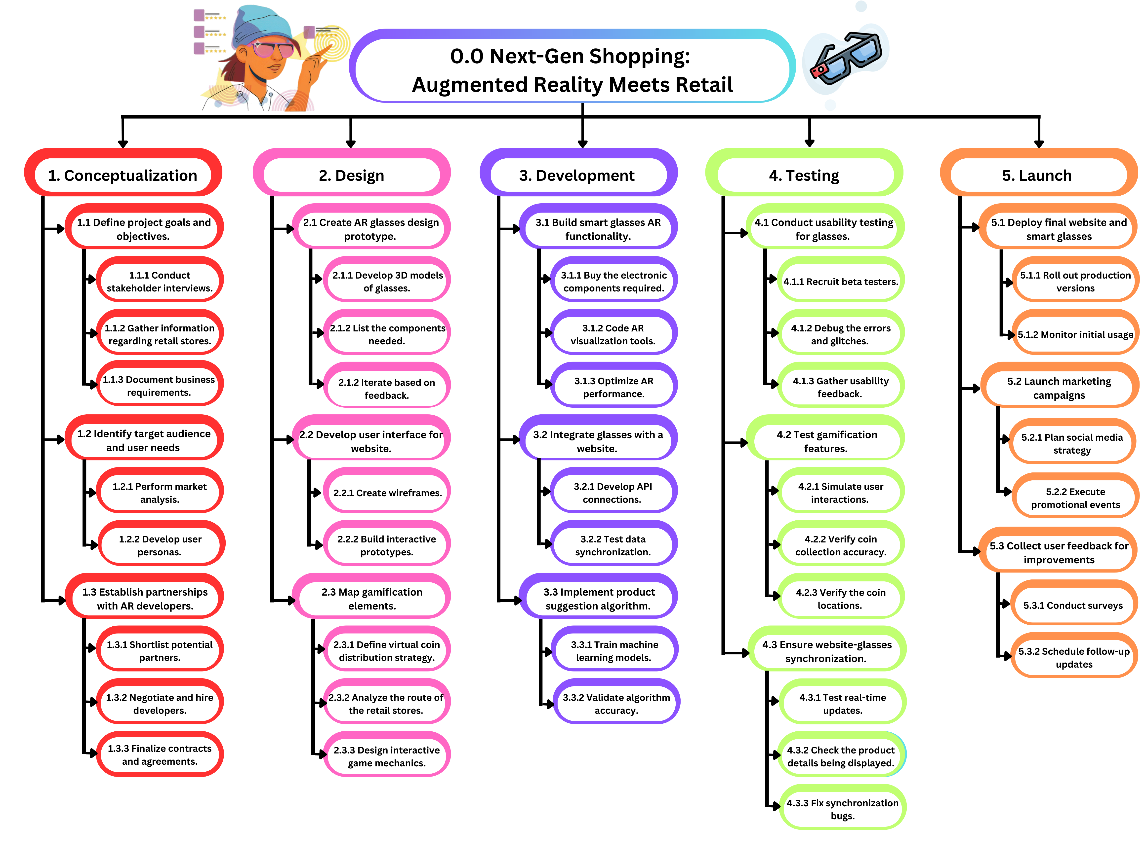
Project Charter
20XX
Development Team
Dates | Event
Within 3rd Month | AR glass prototype completion
Integration Team
Dates | Event
Within 4th Month | Website and glasses integration
QA Team
Dates | Event
Within 6th Month | Gamification Features Testing
Duration | Event | Target Completion Date | Actual Date
Month 1 | Requirement Gathering | 05/12/2024 | 02/12/2024
Month 3 | Prototype design and development | 05/02/2025 | 20/02/2025
Month 6 | User Testing and Feedback | 05/05/2025 | 27/07/2025
Month 9 | Final Product launch | 05/08/2025 | 21/09/2025
Potential Risk | Perceived Impact | Mitigation Strategy
AR Hardware Availability | High | Pre-order Critical components early
Budget Constraints | Medium | Secure additional funding sources
Limited User Engagement | High | Design interactive tutorials
Allocated Budget | Date of Allocation | Revised Budget
10,000,000/- (Ten Million BDT) | 05/11/2024 | 675,000BDT Saved
Approved By | Date | Name
Project Sponsor | 05/11/2024 | Deepak Chandra Roy
Project Manager | 05/11/2024 | Tasfia Tahsin Annita

Slide 12
Work Break Down Structure
20XX

Slide 13
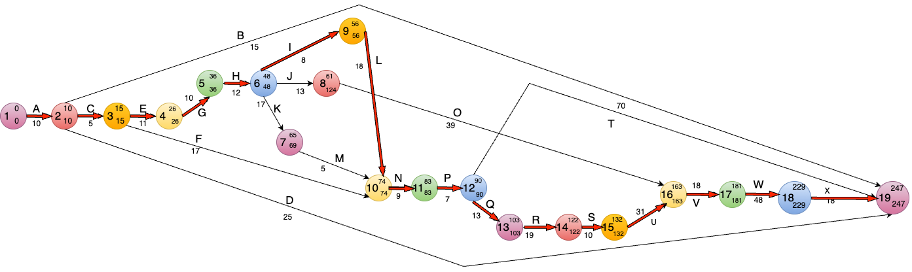
20XX
Network Diagram :

Slide 14
Gantt Chart
20XX
Phase | Task Name | Duration | Start Date | End Date | Predecessors
1. Conceptualization | Define project goals | 10 days | 03/11/24 08:00 | 14/11/24 17:00 | -
 | Conduct stakeholder meetings | 5 days | 03/11/24 08:00 | 07/11/24 17:00 | -
 | Identify target audience | 5 days | 07/11/24 08:00 | 11/11/24 17:00 | 1
 | Perform market analysis | 5 days | 11/11/24 08:00 | 14/11/24 17:00 | 2
 | Develop user personas | 10 days | 14/11/24 08:00 | 22/11/24 17:00 | 2
 | Establish partnerships | 10 days | 14/11/24 08:00 | 22/11/24 17:00 | 6
 | Finalize contracts | 5 days | 22/11/24 08:00 | 28/11/24 17:00 | 6

Slide 15
20XX
2. Design | Create AR glasses 3D models | 20 days | 06/12/24 08:00 | 15/01/25 17:00 | 1
 | Iterate based on testing | 10 days | 15/01/25 08:00 | 28/01/25 17:00 | 18
 | Create wireframes for UI | 15 days | 28/01/25 08:00 | 20/02/25 17:00 | 18
 | Build interactive prototypes | 20 days | 20/02/25 08:00 | 20/03/25 17:00 | 26
 | Map gamification elements | 15 days | 15/02/25 08:00 | 28/02/25 17:00 | 8
3. Development | Build smart glasses | 30 days | 23/03/25 08:00 | 22/04/25 17:00 | 26
 | Develop AR visuals | 20 days | 23/03/25 08:00 | 10/04/25 17:00 | 26
 | Train machine learning models | 15 days | 28/04/25 08:00 | 18/05/25 17:00 | 30
 | Validate algorithms | 15 days | 28/04/25 08:00 | 18/05/25 17:00 | 30

Slide 16
20XX
4. Testing | Conduct usability tests | 20 days | 26/05/25 08:00 | 22/06/25 17:00 | 25
 | Debug the errors | 10 days | 12/06/25 08:00 | 22/06/25 17:00 | 37
 | Gather usability data | 10 days | 26/05/25 08:00 | 09/06/25 17:00 | 37
 | Test gamification | 15 days | 23/06/25 08:00 | 10/07/25 17:00 | 41
 | Simulate user interactions | 10 days | 23/06/25 08:00 | 06/07/25 17:00 | 41
 | Verify coin collection mechanism | 10 days | 06/07/25 08:00 | 10/07/25 17:00 | 42
 | Ensure website-glasses integration | 15 days | 10/07/25 08:00 | 27/07/25 17:00 | 43
 | Test real-time updates | 10 days | 10/07/25 08:00 | 20/07/25 17:00 | 43
 | Check the product sync across devices | 10 days | 14/07/25 08:00 | 27/07/25 17:00 | 45

Slide 17
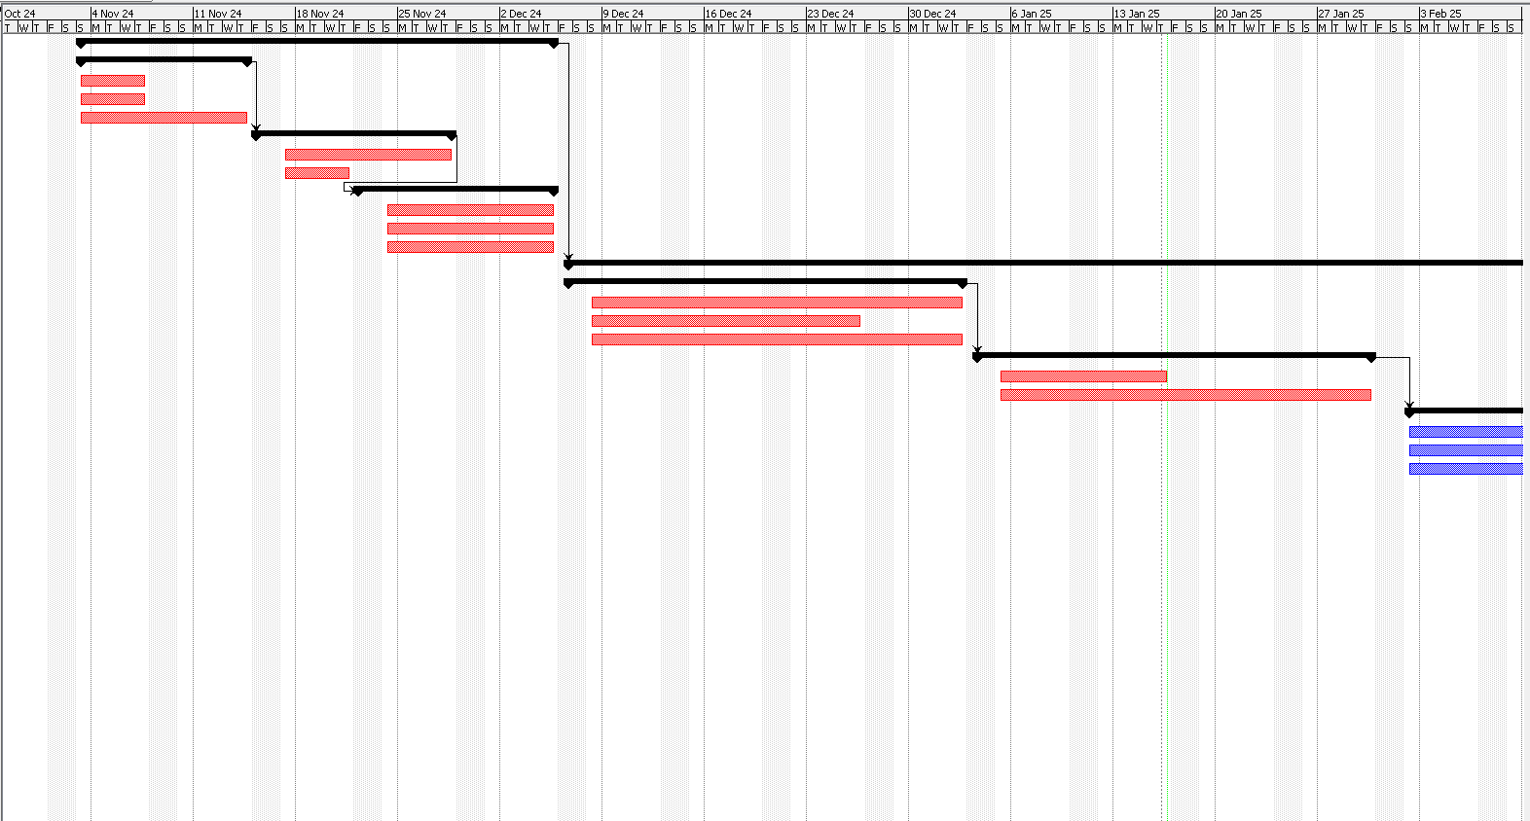
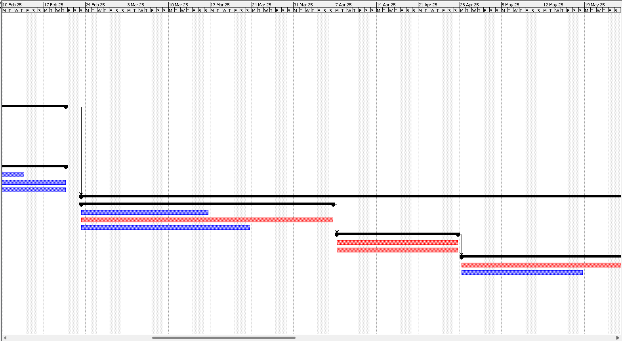
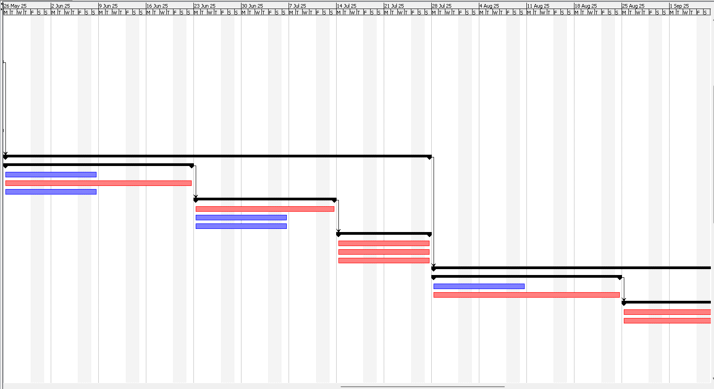
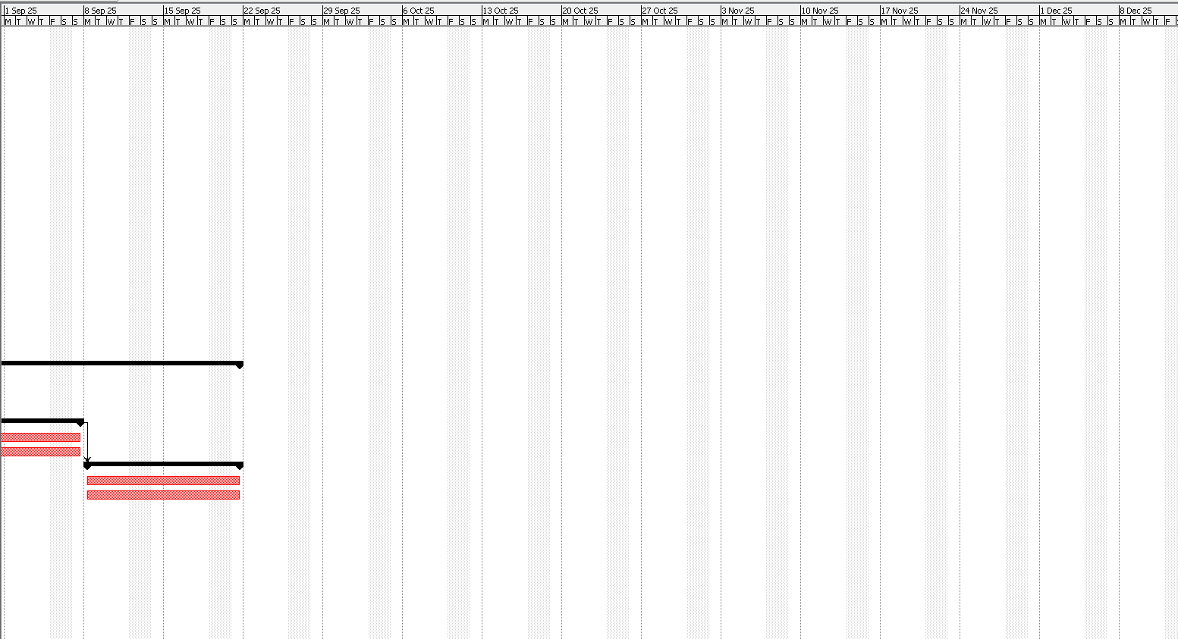
20XX
5. Launch | Deploy final website | 20 days | 28/07/25 08:00 | 24/08/25 17:00 | 36
 | Roll out product updates | 10 days | 28/07/25 08:00 | 07/08/25 17:00 | 50
 | Monitor initial user feedback | 10 days | 24/08/25 08:00 | 04/09/25 17:00 | 50
 | Launch marketing campaigns | 20 days | 25/08/25 08:00 | 07/09/25 17:00 | 50
 | Plan social media advertisements | 10 days | 25/08/25 08:00 | 04/09/25 17:00 | 54
 | Execute promotional events | 10 days | 25/08/25 08:00 | 07/09/25 17:00 | 54
 | Collect user feedback | 10 days | 08/09/25 08:00 | 21/09/25 17:00 | 53
 | Conduct surveys | 10 days | 08/09/25 08:00 | 18/09/25 17:00 | 57
 | Schedule follow-up updates | 10 days | 08/09/25 08:00 | 21/09/25 17:00 | 57

Slide 18
20XX

Slide 19
Effort (Person-Month)
20XX
Cocomo Model
Semi Detached Cocomo Model
Moderate complexity related to AR, AI integration and gamification
Has 4 highly experienced lead members while the other team members are less experienced.
Line of Code (KLOC) is 50
Development Time (Months)
189.3 Person-Month
9 Months
Team Size
21 Persons

Slide 20
Income Statement
Gross Profit
Total Operating Expense
13 Million BDT
7.455 Million BDT
Net Profit
1.38 Million BDT
20XX
Revenue
14 Million BDT
Next Gen Shopping
Income Statement
For the Year Ending 31st December 2025
Total Revenue | 14,000,000
Cost of Goods Sold | 1,000,000
Gross Profit | 13,000,000
Operating Expenses
Payroll | 7,455,000
Development Tools | 200,000
Software Licenses | 150,000
Third Party APIs and Integrations | 70,000
Cloud Service/ Hosting Fees | 30,000
Servers | 120,000
Workstations/ Computers | 80,000
Networking Equipment | 30,000
Accessories | 20,000
Online Advertisement | 70,000
Offline Promotions | 30,000
Branding and Design | 20,000
Events/ Workshops | 30,000
Miscellaneous Expenses | 20,000
Contingency Reserve | 1,000,000
Total Other Costs | 9,325,000
Interest | 1,000,000
Tax (15%) | 401,250
Net Profit | 1373750

Slide 21
Software Costing
20XX
Next Gen Shopping
Income Statement
For the Year Ending 31st December 2025
Total Revenue | 14,000,000
Cost of Goods Sold | 1,000,000
Gross Profit | 13,000,000
Operating Expenses
Payroll | 7,455,000
Development Tools | 200,000
Software Licenses | 150,000
Third Party APIs and Integrations | 70,000
Cloud Service/ Hosting Fees | 30,000
Servers | 120,000
Workstations/ Computers | 80,000
Networking Equipment | 30,000
Accessories | 20,000
Online Advertisement | 70,000
Offline Promotions | 30,000
Branding and Design | 20,000
Events/ Workshops | 30,000
Miscellaneous Expenses | 20,000
Contingency Reserve | 1,000,000
Total Other Costs | 9,325,000
Interest | 1,000,000
Tax (15%) | 401,250
Net Profit | 1373750

Slide 22
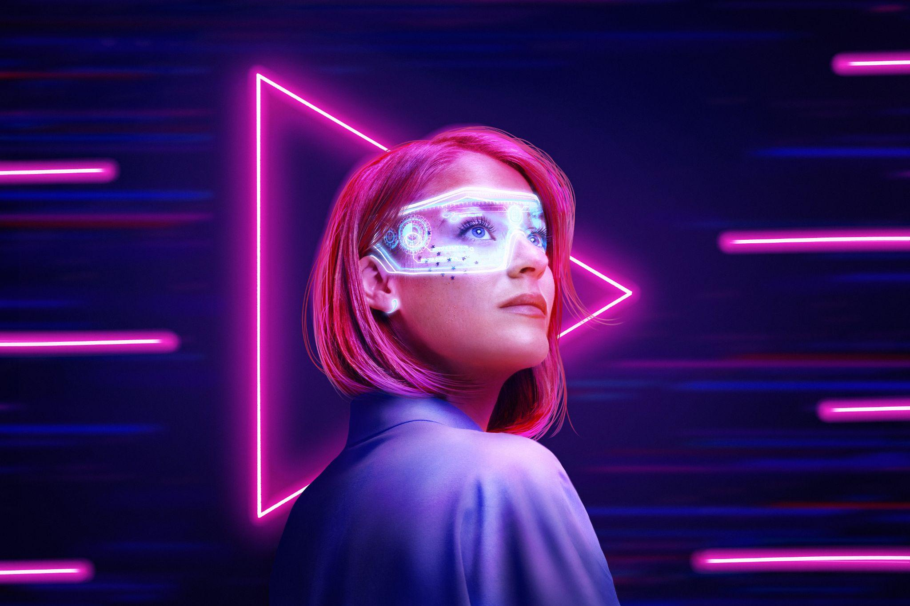

Conclusion
20XX
Augmented Reality and AI redefines shopping, offering an immersive, and efficient retail experience.
This technology enhances convenience and creates a dynamic shopping environment tailored to individual preferences.

Slide 23
THANKS!
20XX
Does anyone have any questions?

